Slide 1
Understanding Directives: Entitlement, Preference Organisation, Progressivity and Intersubjectivity
Alexandra Kent
Keele University
A.Kent@keele.c.uk

Slide 2
Directives
“Utterances designed to get someone to do something” (Goodwin, 2006: 517)
Lots of different ways you can get someone to do something
  I need a match
  Give me a match
  Could you give me a match?
  May I have a match?
  Do you have a match? (Ervin-Tripp, 1976)
Social distance and power might be predictors for more forceful formulations (e.g., Ervin-Tripp, 1976; Pearson, 1989)
Interaction based work is showing a more complicated picture and local, interactional factors need to be considered alongside social relationships (e.g., Heinemann, 2006)

Slide 3
Entitlement and Contingency
(Curl & Drew (2008)
Curl & Drew (2008)
Within the design of the request the speaker can display…
  More or less entitlement to expect the requested action to be carried out
  More or less acknowledgement of the contingencies that might prevent the requested action being carried out
Request formats can be distinguished along a continuum of entitlement and contingency
High entitlement utterances pointedly do not orient to any possibility of not being granted

Slide 4
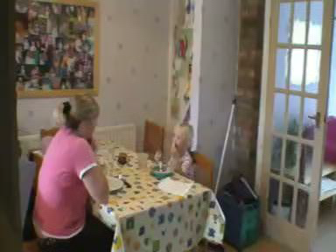
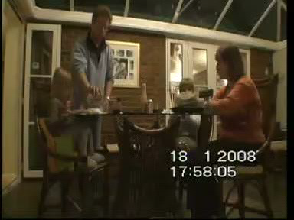
My data
Family Mealtimes
Attempts to get someone to do something
Contained examples of a wide range of directive strategies
Notes:
Led to an interest in sequence where multiple directives addressing the same action were used in sequence

Slide 5
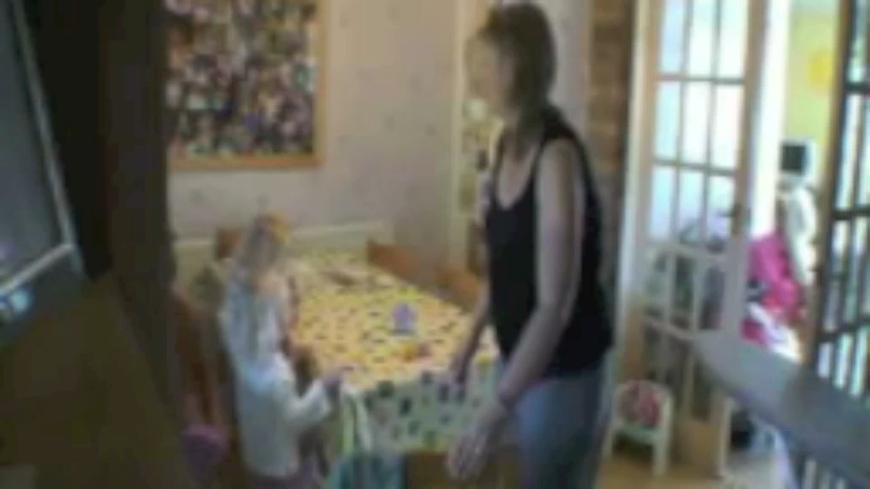
Multiple Directives
(Craven & Potter, 2010)

Slide 6
Multiple Directives
1 Mum [Kath’rine >c’you move< a[long] a little bit ple[ase. ]
2 Mum [((starts to push chair next to Kath)) ]
3 Anna [((moves out of the way of the chair)) ]
4 Anna [.huh] [.hhu:]
5 Kath [((swings legs round to block chair))]
6 Kath [I’wn- I wanna sit[on my ohº:::]
7 Mum [KATh’rine ], [Katherine don’t]=
8 Mum [((shakes head))]
9 Mum =[don’t] be:- (.) do:n’ be horrible.
10 Kath [ºuh! ]
11 Mum [Come on. Mo:ve back ple:[ase.] ]
12 Mum [((restarts pushing chair towards Kath))]
13 Kath [Ah ]
14 Mum [((pushes Kath and her chair backwards))]
15 [(1.8) ]

Slide 7
Multiple Directives
16 Kath [Aa:AH::::::::ooow: ((dur 3.1)) ]
17 Mum [((moves other chair into position))]
18 Mum [((picks Anna up and sits her on the chair))]
19 Kath [Aah::::o[w ((dur 2.8)) ]
20 Mum [Y’need t’be ki:nd to][your si:s]te:r.
21 Kath [OW:: ]
22 Kath ~A:[:::::h~ ]
23 Mum [Now mo:ve your le:g] round the front]
24 Mum [((moves Kath’s leg round)) ]
(0.4)

Slide 8

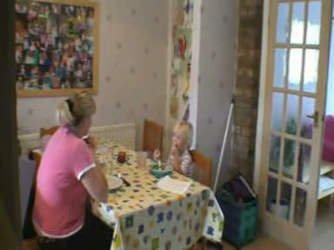
Typical upgrade pattern
When a directive was resisted it was recurrently reissued in an upgraded format

Slide 9
Typical upgrade pattern
When a directive was resisted it was recurrently reissued in an upgraded format:
  Increased display of entitlement to expect the recipient to comply
  Decreased or removed acknowledgment of contingencies preventing compliance
Successive directives progressively increase the degree to which they impinge on the recipient’s freedom of action and autonomy

Slide 10
Choice of directive format
Low entitlement
High entitlement
Does not claim rights over the recipient’s conduct
Control over directed action lies with recipient
Preserves autonomy and intersubjectivity
Recipient has scope to design their response (inc refusal)
Higher likelihood of action not getting done
Claims full entitlement to control recipient’s actions
Speaker assumes control of the directed action
Impinges or removes recipient’s autonomy
Risks conflict or breakdown of intersubjectivity
Higher likelihood of directed action being performed

Slide 11
Preference organisation of sequence-initiating actions (Robinson & Bolden, 2010)
Preferred Action | Dispreferred Action | References
Self correction | Other correction | Schegloff, Sacks & Jefferson (1977)
Offering an object of value | Requesting an object of value | Lerner (1996), Schegloff (2007), Taleghani-Nikazm (2006)
Having positive aspects of oneself noticed | Announcing positive self attributes | Schegloff (2007)
Being recognised during telephone openings | Self-identifying | Schegloff (1979; 2007)
 | Giving unsolicited advice | Heritage & Sefi (1992)
Notes:
As an initiating action, a directive is a highly invasive social act. Breaking into an ongoing conversation, halting it, and issuing a command for someone else to do something could threaten their “public self image”, or face Brown & Levinson, 1987, p62}}. Using Brown & Levinson’s theoretical conceptualisation of face, directives can be seen as a face-threatening act that promotes disaffiliation between the two participants. Goffman {{1967; 1983} suggested that a key feature of the organisation of human interaction was the promotion of social affiliation over disaffiliation. Work on preference organisation within conversation analysis has provided empirical support for Goffman’s initial claim {Heritage, 1984; Lerner, 1996; Sacks, 1987; Schegloff, 2007}}. Thus, face threatening, or disafiliative actions have been systematically shown to be dispreferred in interaction

Slide 12
Preference organisation of directives
“a systematic feature of dispreferred FPPs, and evidence for their dispreferred status, is that they are withheld relative to points in interaction where they might otherwise have been initially relevantly performed” (Robinson & Bolden, 2010: 503)
Highly entitled directives are recurrently delayed in favour of less entitled formulations
  Highly entitled directives are dispreferred formats for ‘getting someone to do something’
But entitled directives do not exclusively occur as upgrades to less entitled first versions…

Slide 13
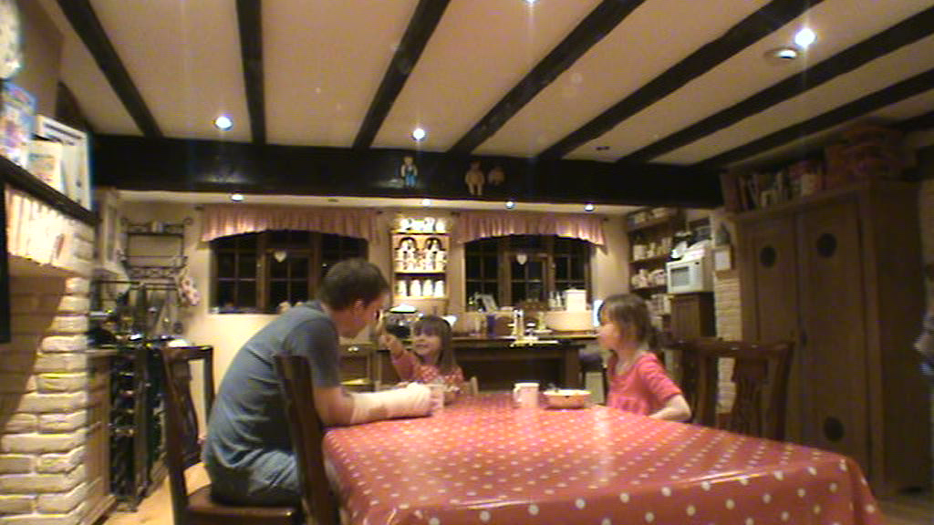
Single directives

Slide 14
Single directives
8 Daisy And you wen’ no:: and Lou came up to me and said,
9 (0.7).hh [there’s] BEe:r in (.) um (0.6) [gra:pes]
10 Lucy [((some food falls off her fork into her
11 lap while she’s trying to get a large mouthful
12 into her mouth)) ]
13 Dad [Lu: ]cy:::.
14 [[(.)
15 Lucy [[((picks up the dropped food and puts it back in
16 her bowl))
17 Dad LOO:k at what you’re do:ing::.
18 [(3.9) ]
19 Lucy [((does a deep nod and then keeps her head down
20 looking at her bowl))]
21 Dad [[((watches Lucy))
22 Mum So wuz your bi:ke [alri:ght?, did Rupert sa:y?]

Slide 15
Single directives
The directive typically…
  Indexes some aspect of the recipients prior conduct as requiring an immediate directive to change
  Breaks into the ongoing talk to claim a locally occasion entitlement to tell the recipient what to do
Choosing to use a highly entitled directive formulation as a first attempt is markedly disaffiliative / forceful.

Slide 16
Preference organisation of directives
“when explicit solicitations of accounts are not withheld, they embody an aggravated stance of challenge/disaffiliation” (Robinson & Bolden, 2010: 527).
Violating the preference structure …
  accentuates the highly entitled nature of the directive
  Starkly prioritises ‘getting the action done’ over maintaining intersubjectivity
  Displays a marked lack of concern with the recipient’s autonomy
  or freedom of action

Slide 17
Two ways to account for different directive formats
Entitlement and contingency
Preference organisation
High entitlement privileges progressivity of action above all other concerns
  Risks a breakdown in intersubjectivity
Low entitlement privileges the recipients autonomy and maintaining intersubjectivity
  Risks not getting the action done
High entitlement directives are disaffiliative social actions.
  They are dispreferred and recurrently withheld in interaction
Not withholding a highly entitled directive marks the utterance as particularly unconcerned with the recipients autonomy

Slide 18
References
CRAVEN, A. and POTTER, J., 2010. Directives: Entitlement and Contingency in Action. Discourse Studies, 12(4), pp. 419-442.
CURL, T. and DREW, P., 2008. Contingency and Action: A Comparison of Two Forms of Requesting. Research on Language and Social Interaction, 41(2), pp. 129-153.
ERVIN-TRIPP, S., 1976. Is Sybil there? The structure of some American English directives. Language in Society, 5, pp. 25-66.
GOODWIN, M.H., 2006. Participation, affect, and trajectory in family directive / response sequences. Text and Talk, 26(4-5), pp. 515-543.
HEINEMANN, T., 2006. 'Will you or can't you?': Displaying entitlement in interrogative requests. Journal of Pragmatics, 38, pp. 1081-1104.
HERITAGE, J. and SEFI, S., 1992. Dilemmas of advice: aspects of the delivery and reception of advice in interactions between health visitors and first-time mothers. In: P. DREW and J. HERITAGE, eds, Talk at Work: Interaction in Institutional Settings. Cambridge: Cambridge University Press, pp. 359-417.
LERNER, G., 1996. Finding "face" in the Preference Structures of Talk-in-Interaction. Social Psychology Quarterly, 59(4), pp. 303-321.
PEARSON, B., 1989. "Role-ing Out Control" at Church Business Meetings: Directing and Disagreeing. Language Sciences, 11(3), pp. 289-304.
ROBINSON, J.D. and BOLDEN, G.B., 2010. Preference organisation of sequence-initiating actions: The case of explicit account solicitations. Discourse Studies, 12(4), pp. 501-533.
SCHEGLOFF, E.A., 1979. Identification and Recognition in Telephone Openings. In: G. PSATHAS, ed, Everyday Language: Studies in Ethnomethodology. New York: Irvington Publishers, pp. 23-78.
SCHEGLOFF, E.A., 2007. Sequence Organisation in Interaction: A Primer in Conversation Analysis. Cambridge: Cambridge University Press.
SCHEGLOFF, E.A., SACKS, H. and JEFFERSON, G., 1977. The preference for self-correction in the organization of repair in conversation. Language, 53(2), pp. 361-382.
TALEGHANI-NIKAZM, C., 2006. Request Sequences: The intersection of Grammar, Interaction and Social Context. Philadelphia: John Benjamins.

