Slide 1
Ela+(re)+name: defending one’s position
Angeliki Balantani
University of Essex

Slide 2
Definition and the phenomenon
Έρχομαι (=to come)
Έλα → imperative form
Practice | Examples
A: Assertion | When [I took it out then: when: you said it is purple (.) then we should have taken it out.
B: Disagreement /resistance | [When I:: cut] the last one it could not be che↓wed re guys
A: Ela+(re)+name | [E↓la re Kelvin.
B: Back down | =I- it also depends how it was as you said

Slide 3
The context
Competitiveness in interaction
Epistemics
  “…the distribution of rights and responsibilities regarding what participants can accountably know, how they know it, whether they have rights to describe it and in what terms…” (Heritage & Raymond, 2005: 16).

Slide 4
The context (cont.)
Clayman (2013)
  on prefatory address terms
Example from Clayman (2013: 296):
(Schegloff, 1980: 112--113)
1 Fred: Oh by the way((sniff))I have a bi:g favor to ask ya.
2 Laurie: Sure, go’head.
3 Fred: ’Member the blouse you made a couple weeks ago?
4 Laurie: Ya.
5 Fred: Well I want to wear it this weekend to Vegas but my
6 mom’s buttonholer is broken.
7 Laurie: -> Fred I told ya when I made the blouse I’d do the
8 buttonholes.
9 Fred: Ya ((sniff)) but I hate ta impose.
10 Laurie: No problem. We can do them on Monday after work.

Slide 5
Data
Data collection → audio- and video-recordings of 17 and a half hours
Participants → friends and family members from diverse age groups and socioeconomic backgrounds

Slide 6
M2U00061 (L: Leandro, K: Kelvin, V: Vanessa)
24 L: Otan to [‘vgala ego tote: pu: ipes ine mov (.) tote ‘prepe
25 na to vgalume.
When [I took it out then: when: you said it is purple (.) then we
should have taken it out.
26 L: [((upward movement of the face))
27 (0.6)
28 V: Ne tote tha ihe zumia bra[vo afto: li:: afto lipi]
Yes then it would have had juices exac[tly this: is mi:: this is
missing]
29 K: [Otan ekopsa ego::] to telefteo de
30 masi↓tan re pedia
[When I:: cut] the last one it could not
be che↓wed re guys
31 (0.1)
32 L:→ [E↓la re Kelvin.
[Co↓me on re Kelvin.
33 L: [((mouth full of food))=
34 K: =I- ine analoga ke pos itan opos ipes
=I- it also depends how it was as you said
35 [(0.5)
36 L: [((nods))
37 K: to psisimo
the roasting
38 (0.5)
39 K: Telospanton=
Anyway=
40 L: =Kalo itan.
=It was good.

Slide 7
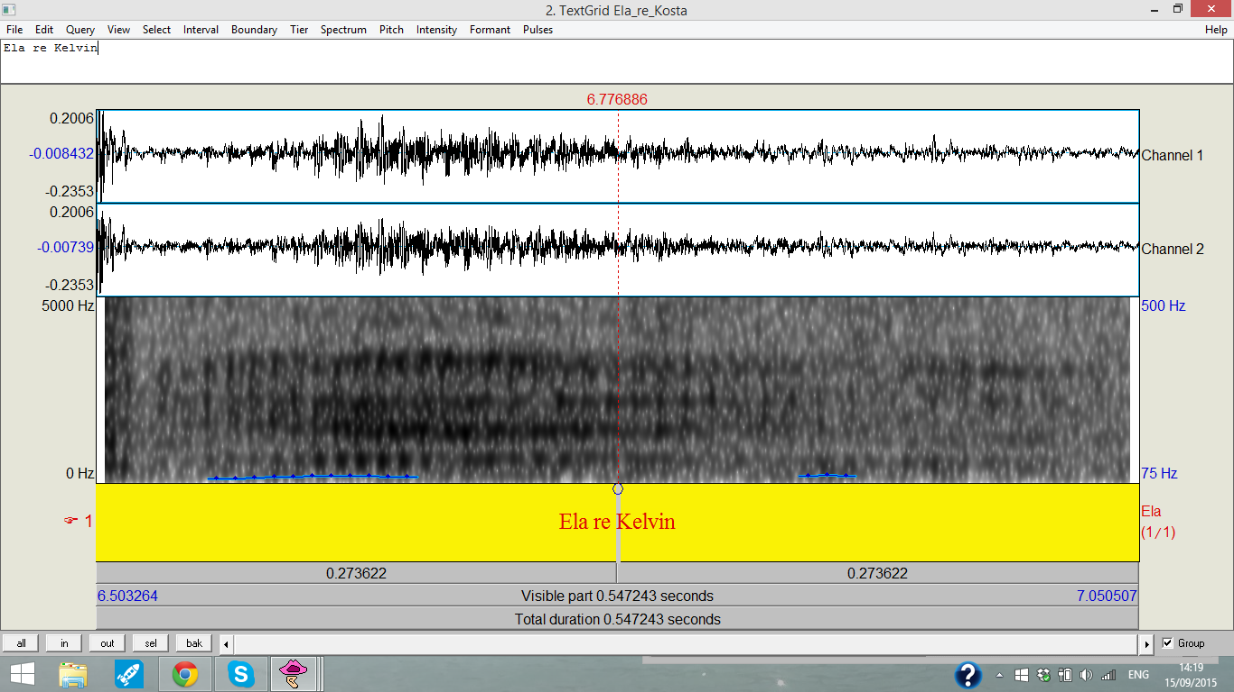
Figure 1

Slide 8
M2U0061 (L: Leandro, K: Kelvin, V:Vanessa)
9 L: [>’a [dume tha ‘n eh’ anameni ti soba?==[de tha ‘n eh’.<
[>Let’s [see will he have it turned on the stove?==[he won’t have it.<
10 (0.8)
11 K: Tha fi’is tri:s tha ‘se pent[emis’
You will leave at three: you will be at five th[irty
12 L: [((raises his eyebrows and
13 slightly moves his head back to indicate no))
14 (0.1)
15 L: Ime [si[guros
I am [su[re
16 V: [Les¿
[You think¿
17 L: E [hi-hilia] ta ekato
E [a hu-hundred] per cent
18 (0.6)
19 K: O: pate↓ras su les
You:r fa↓ther you mean
20 (0.2)
21 L: [hhh
22 L: Pateras den bori more i mana m’=
My father can’t more my mother=
23 V: [Aftos tha tin anapsi omos tha dis aftos tha- ki ama [tha:
24 rotisis aftos tha t’n eh’ ana[ps’
[He will turn it on however you will see he will- and if [you will:
ask he will have tu[rned it on
25 K: [Bori na min eh’ ke krio more:
[Maybe it won’t be so cold more:
26 (0.3)
27 V:→ Ela re: Kelvin den eh’ ºkr[ioº
Come on re: Kelvin it won’t be ºco[ldº
28 L: [Eh’.
[It is.
29 K: [Ala tha m’ pis an den eh’ to:
30 kalo[rifer
[But then if he hasn’t got the:
[radiator
31 V: [Ets’ opos ehun math’ afti:::
32 [As they::: are used to
33 (0.2)
34 V: den tus ftan’ to kalorifer
the radiator is not enough for them

Slide 9
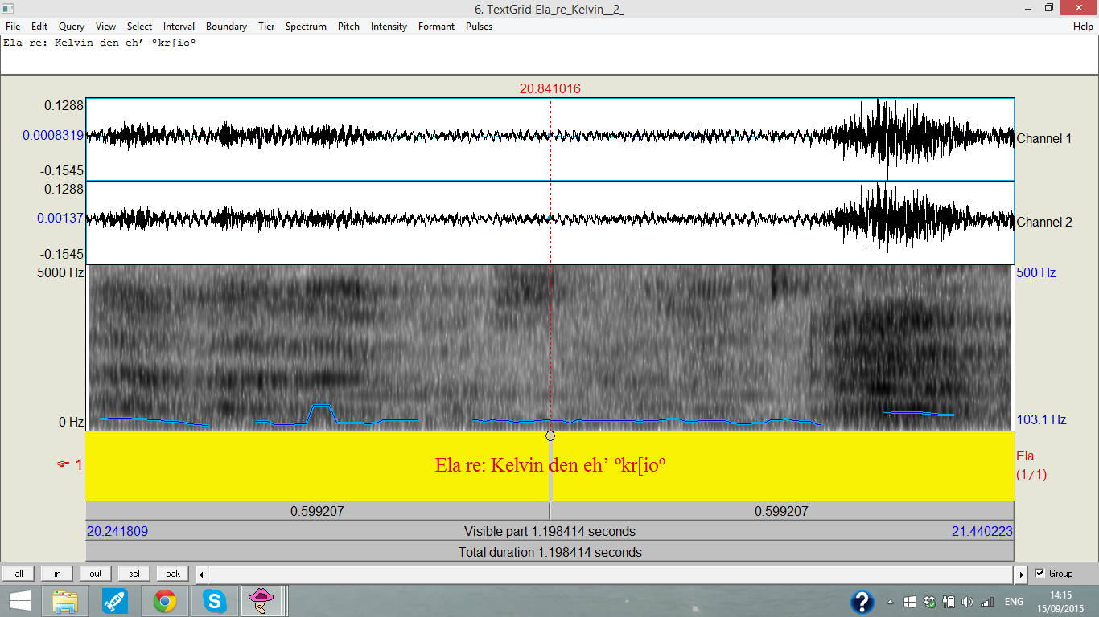
Figure 2

Slide 10
Discussion over the political developments
5 E: ke [fisika pali distihos tha po dikeonomaste=
and [of course again unfortunately I will say we are vindicated=
6 D: =[Oli dikeoneste [pali ta idia]
=[Everyone is vindicated [again the same]
7 B: [( )]
8 E: [di- o↓h’ oh’ >mono emis dikeo[nomaste giati oli
9 ligo poli alazun tis thesis tus==emis imaste [statheri apo tin
10 proti stigmi giati ehume [pi<
[ven- no↓ no >only we are vendi[cated because everyone more or less change their
positions==we are [constant from the first moment because we have [said<
11 D: [Ma ki o Siriza dikeonete [ºetsi leiº
[But Siriza is also vindicated [ºso they sayº
12 E: [E:hume pi oti ehume mia
13 [<politiki stathe]ri>
[We ha:ve said that we have a [<consta]nt policy>
14 D: [Ki i kivernisi dikeonete ºtha sas piº]
[The government is also vindicated ºthey will tell youº]
15 (0.2)
16 B:→ [Elate kiria Kountoura]
[Come Mrs. Kountoura]
17 E: [I: a-]
[The: a-]
18 (0.2)
19 E: >Kitakste ama ine na milane i ali apo ena tetarto ki emena na mu
20 [lete elate me to pu [aniksa to stoma mu:↑<
>Look if the others talk for a quarter and to me [you say come the moment [I opened my mouth:↑<
21 B: [Ela↑te ohi na mili↑sete leo [na mi sas
22 diakoptume ( )
[Co↑me no I mean ta↑lk [so that we don’t interrupt you ( )
23 D: [Elate
24 proho[riste leme de leme sama[ti↓ste=
[Come go ah[ead we say we don’t say st[o↓p=
25 E: [ººE neºº ((nods))
[ººE yesºº ((nods))
26 E: [Afto leo e:m
[That’s what I mean e:m
27 B: =Prohoriste ne
=Go ahead yes
28 E: £Pro[spatho£
£I am t[rying£

Slide 11
Summary
After sequences of epistemic incongruence
Followed by a back down
Closing implicative

Slide 12
References
Clayman, S. (2013). Agency in Response. Journal of Pragmatics, 57, 290-302.
Drew, P. (2003). Precision and Exaggeration in Interaction. American Sociological Review, 68 (6), 917-938.
Heritage, J. & Raymond, G. (2005). The Terms of Agreement: Indexing Epistemic Authority and Subordination in Talk-in-Interaction. Social Psychology Quarterly, 68 (1), 15-38.
Nikiforidou, K. (submitted) Grammatical Constructions and Cross-text Generalizations: Empathetic Narration as Genre.

Slide 13


